Slide 1
PHASE-I Exhaustive Search + Bisection Method
Group: G7
Members: Anupam Khandelwal & Konark Jain

Slide 2
Exhaustive Search Algorithm
function exhaustive_search()
Inputs: a, b, n, function_name
Output: X (1X3 array initialized as [ 0 0 0 ])
delta ← (b-a)/n
x1 ← a
x2 ← x1 + delta
x3 ← x2 + delta
while x3 <= b
y1 ← function_name(x1)
y2 ← function_name(x2)
y3 ← function_name(x3)
if y2 <= y1 & y2 <= y3
X₁ ← 1
X₂ ← x1
X₃ ← x3
break
else
x1 ← x2
x2 ← x3
x3 ← x3 + delta

Slide 3
Bisection Method Algorithm
function bisection_search()
Inputs: x1, x3, del_x, e, function_name
Output: z
z1 ← x1
z2 ← x3
z ← (z1+z2)/2
dz ← (function_name(z+del_x)-function_name(z-del_x))/(2*del_x)
while |dz| > e
if dz > 0
z2 ← z
else
z1 ← z
z ← z ← (z1+z2)/2
dz ← (function_name(z+del_x)-function_name(z-del_x))/(2*del_x)

Slide 4
Combined Algorithm
X = exhaustive_search(a, b, n, function_name)
if X₁ = 1
// Successful exhaustive search call.
minima = bisection_search(x1, x3, del_x, e, function_name)
else
// Unsuccessful exhaustive search call implying monotonicity in the search interval.
if function_name(a) <= function_name(b)
minima = a // Monotonically increasing function.
else
minima = b // Monotonically decreasing function.

Slide 5
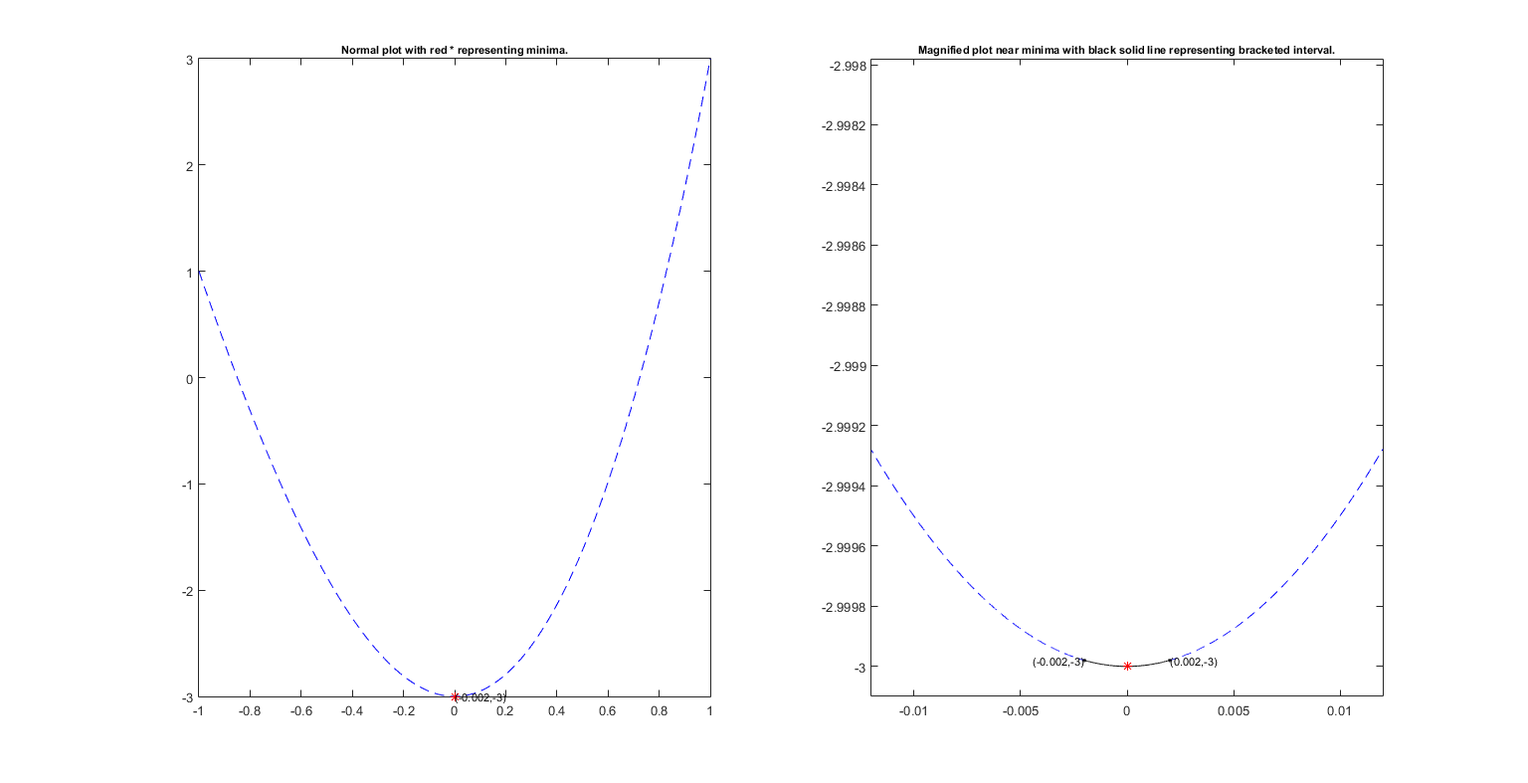

Minimize $f\left(x\right)=x^{3}+5x^{2}−3$ in (-1,1)

Slide 6
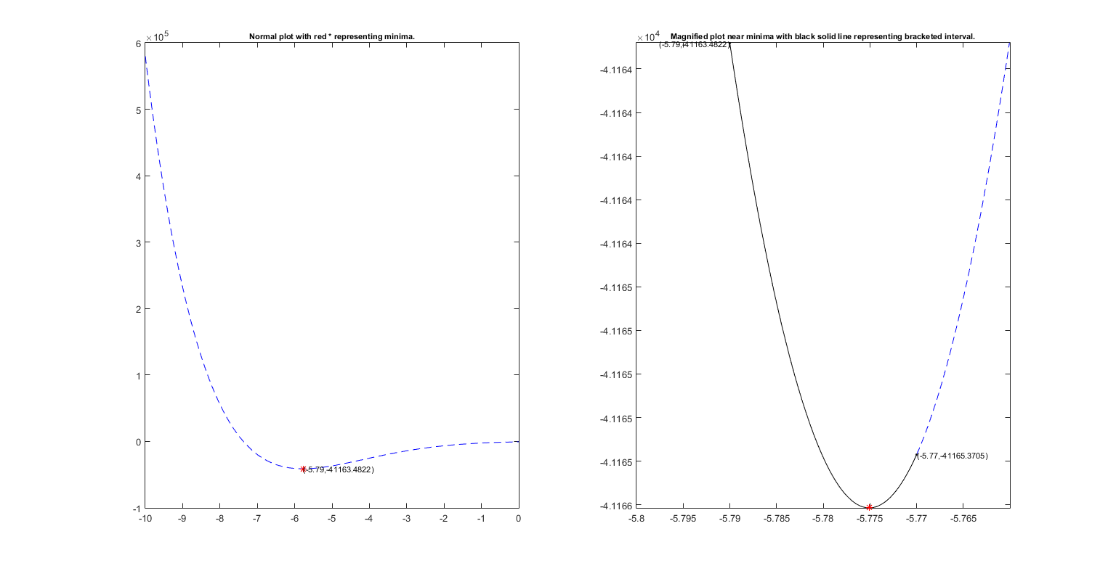

Minimize $f\left(x\right)={\left(x^{2}−1\right)}^{3}−{\left(2x−5\right)}^{4}$ in (-10,0)

Slide 7
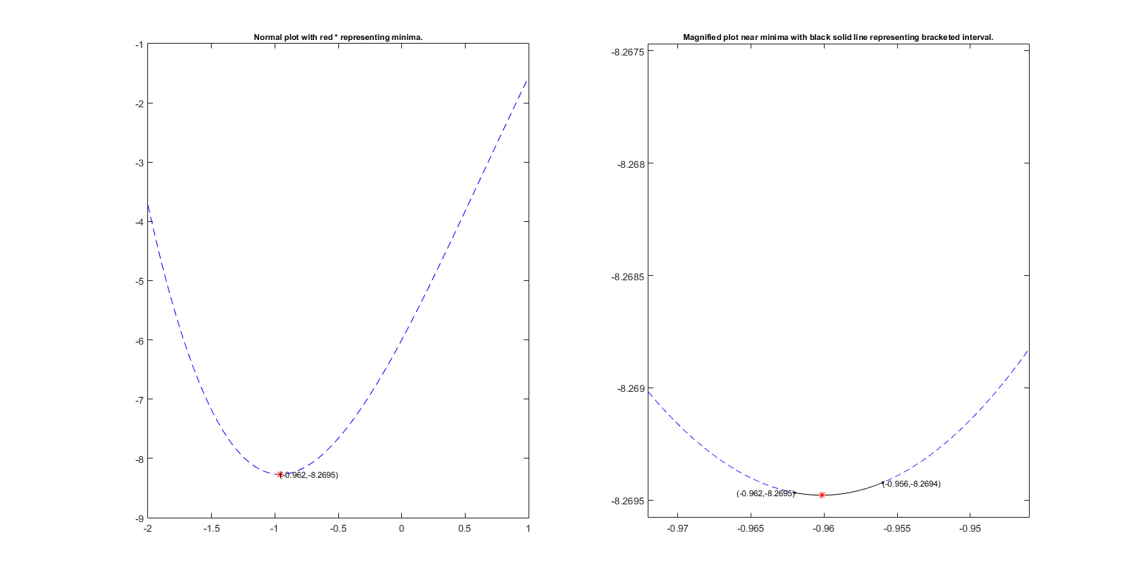

Minimize $f\left(x\right)=2x+2e^{x}−x^{3}−8$ in (-2,1)

Slide 8
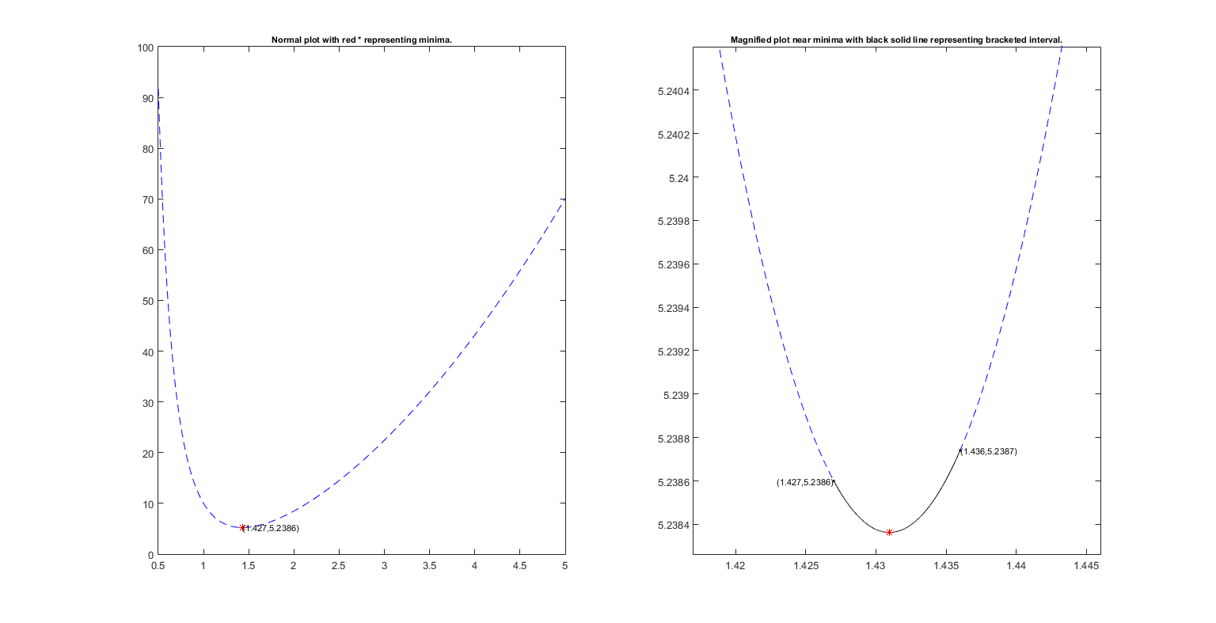

Minimize $f\left(x\right)=3x^{2}+\frac{12}{x^{3}} −5$ in (0.5,5)

Slide 9
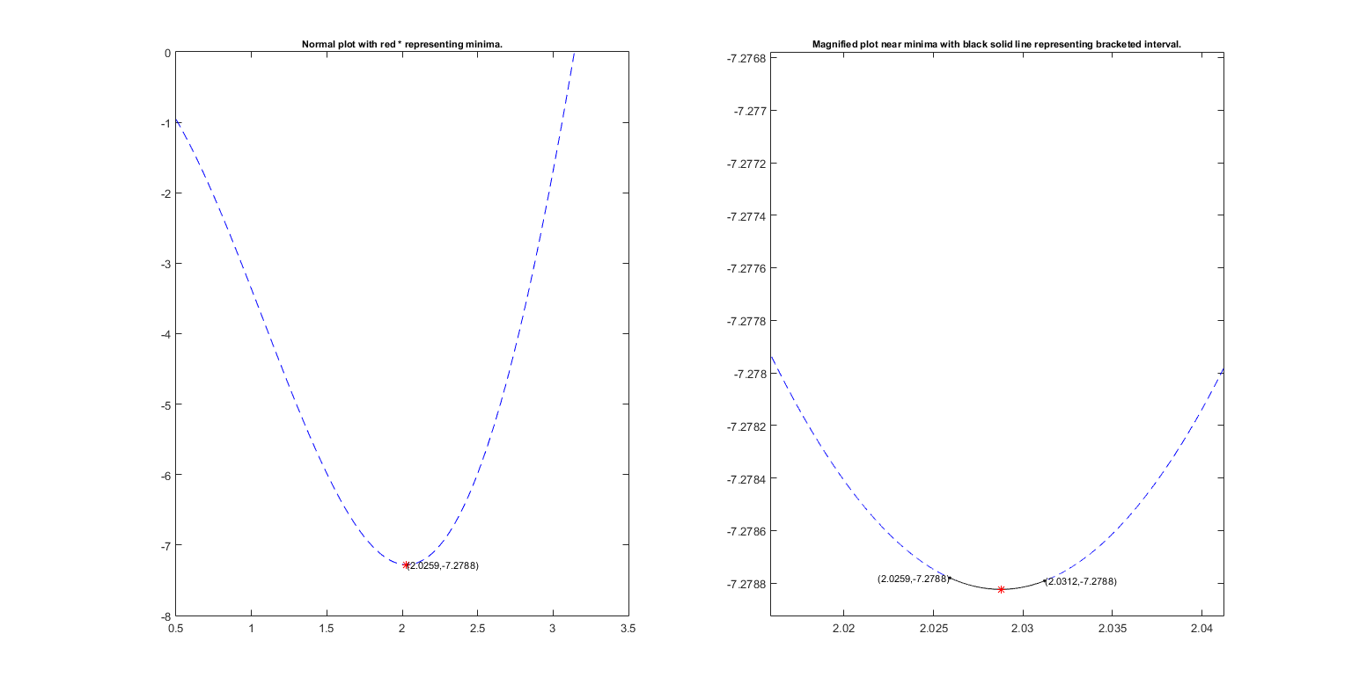

Minimize $f\left(x\right)=−4x(sinx)$ in (0.5,3.14)

Slide 10
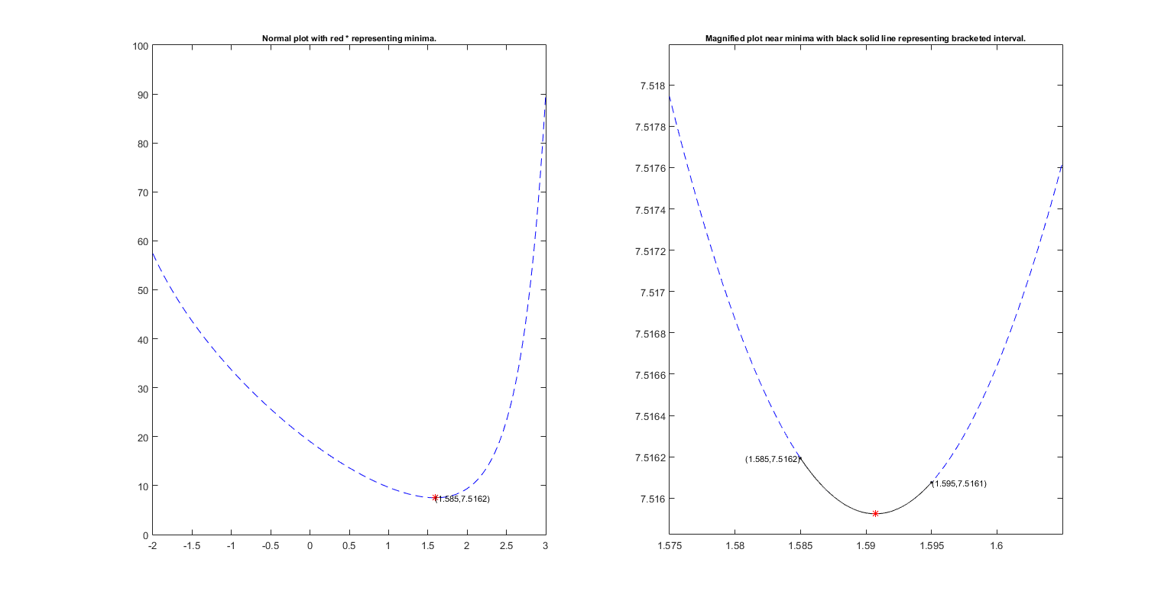

Minimize $f\left(x\right)=2{\left(x−3\right)}^{2}+e^{0.5x^{2}}$ in (-2,3)

Slide 11
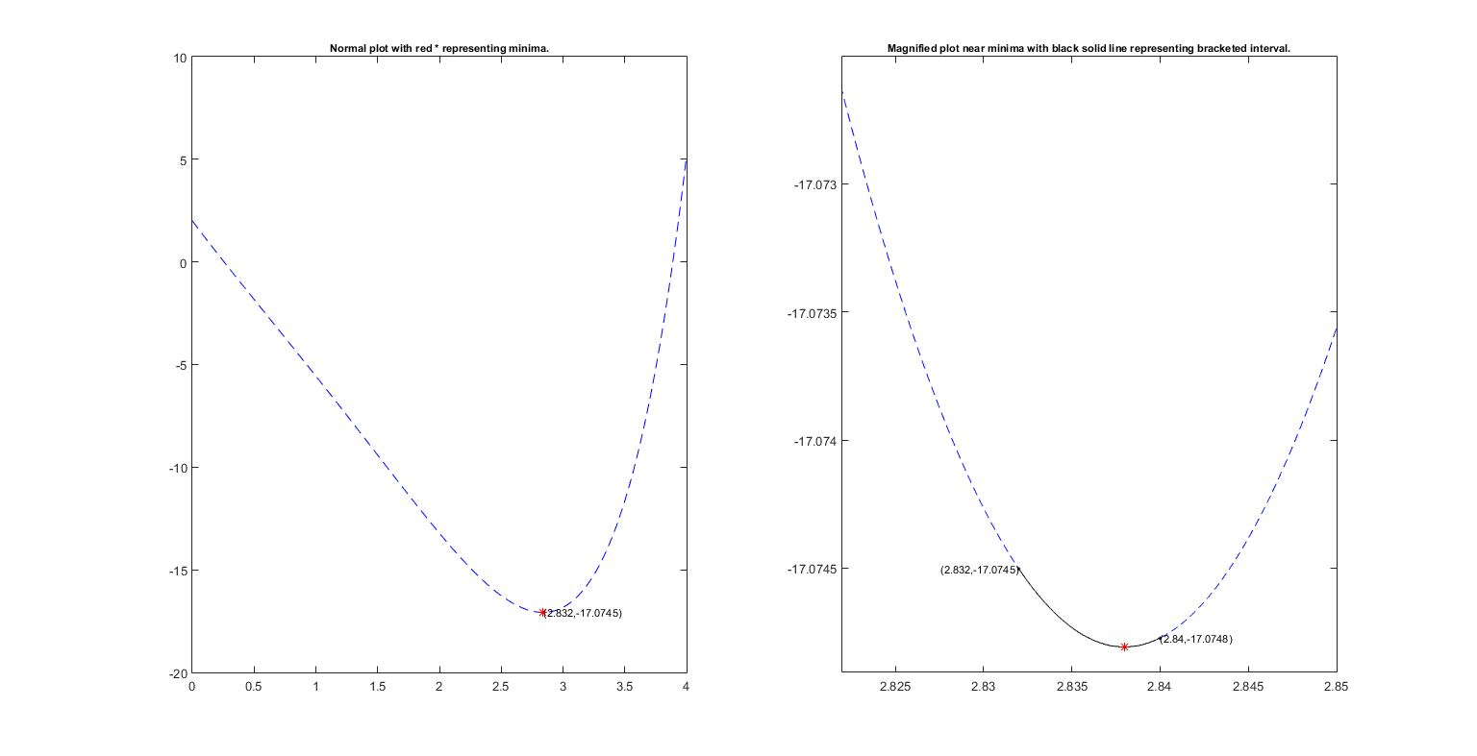

Minimize $f\left(x\right)=2e^{x} −x^{3} −10x$ in (0,4)

Slide 12
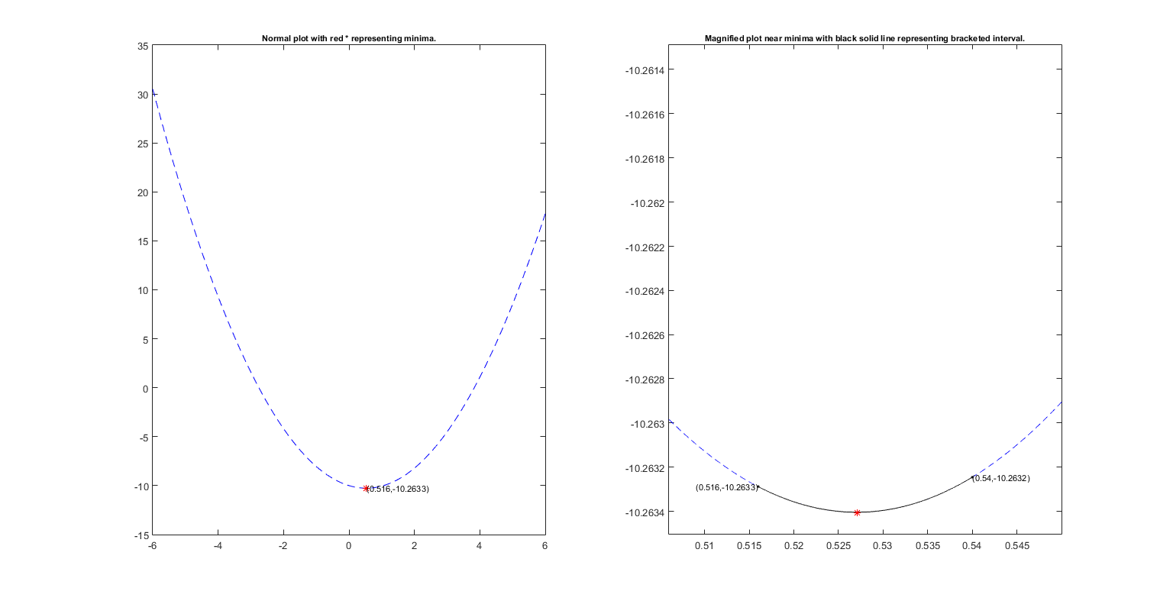

Minimize $f\left(x\right)=x^{2} −10e^{0.1x}$ in (-6,6)

Slide 13
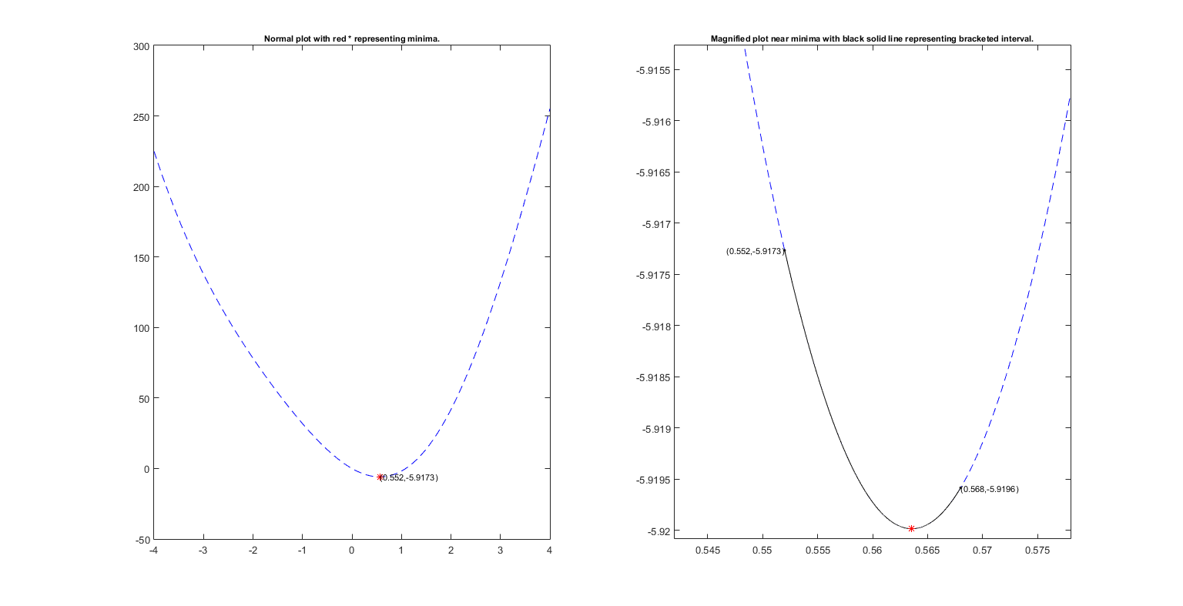

Minimize $f\left(x\right)=15x^{2} −20sinx$ in (-4,4)

Slide 14
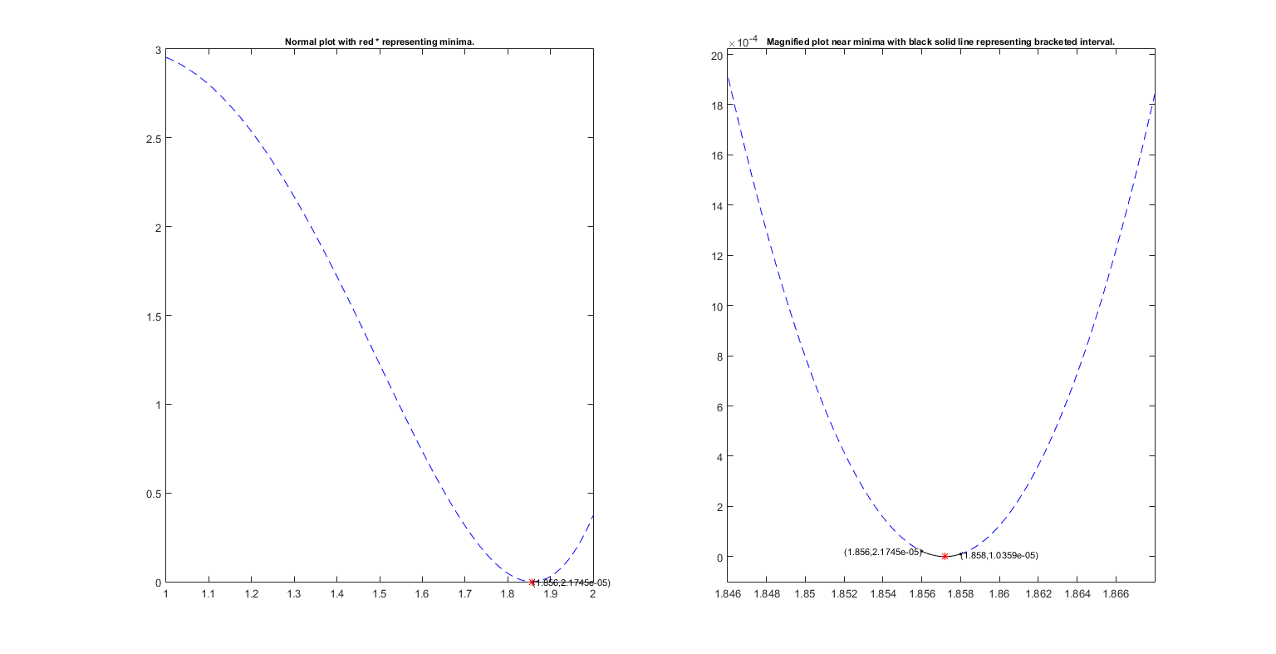

Minimize $f\left(x\right)={\left(e^{x} −x^{3}\right)}^{2}$ in (1,2)

